Slide 1
Generative AI and Language Understanding: Part 8
Sandiway Fong
University of Arizona

Slide 2
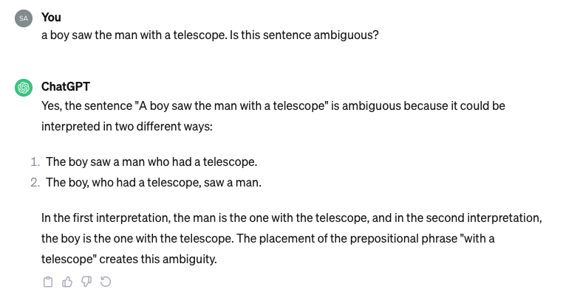
Simple PP attachment
Free version: 3.5
I'm told 4.0
doesn't do this …
Missing instrument with

Slide 3
Simple PP attachment
Possessional with modification not possible with subject.
Not possible!
Phrase structure
would have crossing
CHATGPT doesn't know this

Slide 4
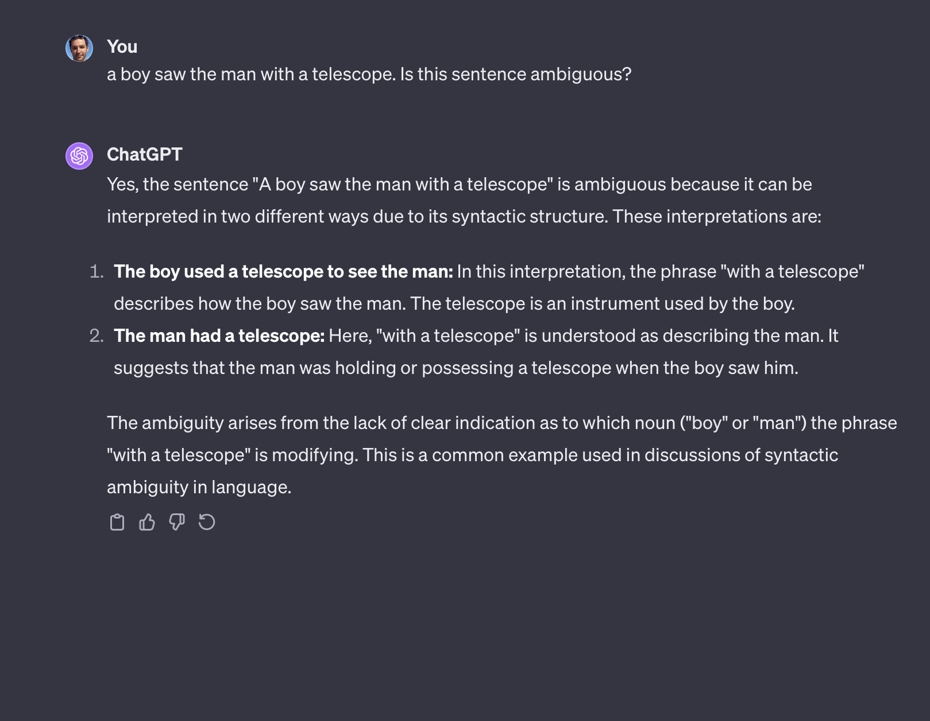
ChatGPT 4
A better answer than the free ChatGPT 3.5!

