Slide 1
Generative AI and Language Understanding: Part 3
Sandiway Fong
University of Arizona

Slide 2
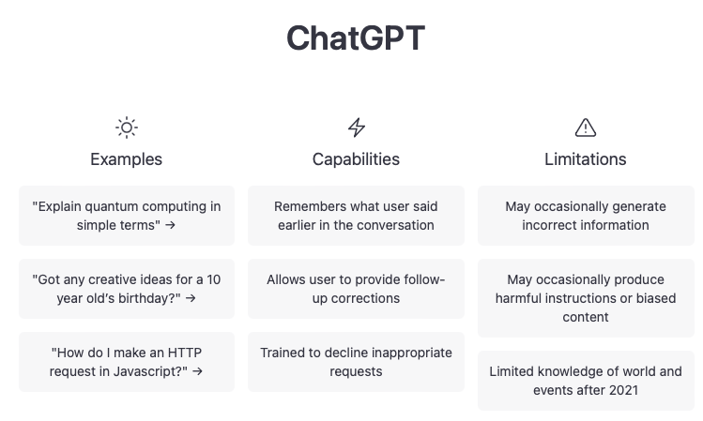
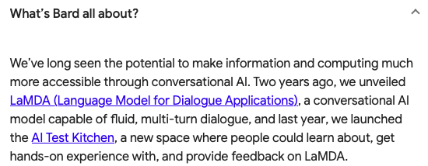
This is the era of Generative AI
https://bard.google.com
https://chat.openai.com/chat

Slide 3
Part 3
ChatGPT and Literature
it knows a lot about well-known poems etc.
Google Bard seems to have a strong tie-in with its search results, see Part 2 for example.
so we expect it to be well-informed too.
but our expectations will be confounded.

Slide 4
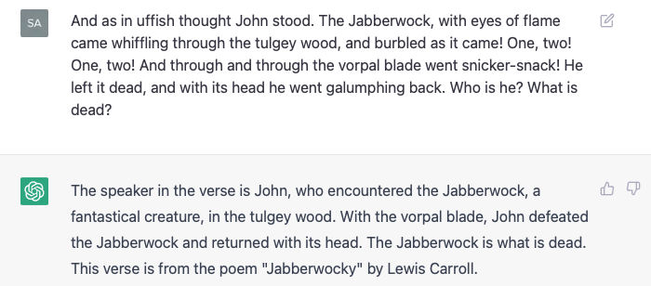
ChatGPT and Literature
John isn't in the (original) poem. I put it in here.

Slide 5
Google Bard
Hmm, ChatGPT has a lot more to say, see next slide

Slide 6
ChatGPT and Literature
ChatGPT possesses encyclopedic knowledge about verses of Jabberwocky.

Slide 7
ChatGPT and Literature
Let's rewrite, i.e. mangle, the verse a bit, rearranging the phrases etc.:

Slide 8
Google Bard

Slide 9
ChatGPT and Literature
Let's replace the Carroll neologisms, i.e. invented words, as well:
John stood in angry thought. With eyes of flame, whiffling through the thick and dark wood and warbling came the Jabberwock. One, two! One, two! Swish-slash went the deadly blade, piercing through and through, leaving it dead! Taking its head, he galloped triumphantly back home.
Notes:
uffish -> angry: Carroll explained the word as "a state of mind when the voice is gruffish, the manner roughish, and the temper huffish."
tulgey -> thick and dark: thick, dense, dark (originally in reference to a wood).
burble -> warble: in a letter, however, [Carroll] said it likely was a combination of bleat, murmur and warble.
snicker-snack -> swish-slash: possibly referring to sharpness, or the sound of a blade cutting through something.
vorpal -> deadly: vorpal meaning "sharp or deadly" was coined by Carroll in 1871.
galumph -> galloped triumphantly: galumph means "to move heavily and clumsily," and is a blend of gallop and triumph.
I assume whiffle is not an invention here: 1662, in sense “flutter as blown by wind”.

Slide 10
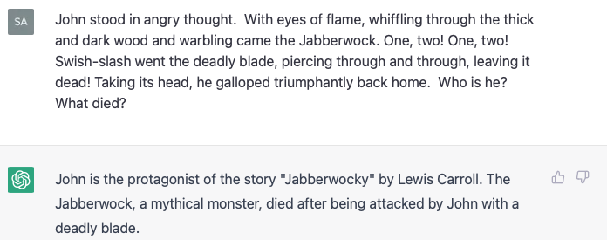
ChatGPT and Literature
deadly isn't in the (original) poem.

Slide 11
Google Bard

Slide 12
more slides to be inserted here

